Slide 1
Introduction to iOS Development
iOS session
#KCLTechBuildX
Session 101
Alex Telek
Clarence Ji
KCL Tech iOS Engineers
© 2016 KCL Tech Society. All rights reserved. Redistribution or public display not permitted without written permission from KCL Tech Society.

Slide 2



What You Will Learn
iOS 9
OS X 10.11
watchOS 2
tvOS 9
Swift 2
Xcode 7
© 2016 KCL Tech Society. All rights reserved.

Slide 3
iOS Sessions
Every week - Tuesday @ 6:30pm, JCMB B.17
Start with basics (iOS, OS X, watchOS, tvOS, Swift, Xcode)
UI
Custom Views and Animations
Concurrency and Multithreading
3D Touch
Foundation, UIKit, CoreLocation, CoreImage, CoreData, MapKit, CloudKit, WatchConnectivity, ClockKit….
Quickly becomes challenging
Learn by doing, not by listening!
Public Slack kcltechhq.slack.com - #ios-programming
© 2016 KCL Tech Society. All rights reserved.

Slide 4

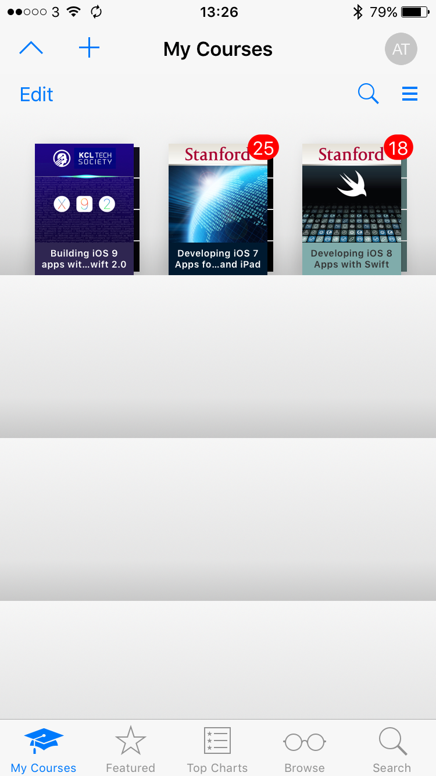
iTunes U
KCLTech iOS sessions on iTunes U
Weekly update
Materials
FWJ-BTY-PSJ
Videos
Discussions
Assignments
© 2016 KCL Tech Society. All rights reserved.

Slide 5
WWDC16
World Wide Developer Conference in San Francisco
300 Student Scholarship Recipients
1. Create an App (Developer Account)
- Development Projects
- Educational background
- Professional background
- Technical skills
- Interest
2. Judging
- Technical accomplishment
- Creativity of ideas expressed in the app
Deadline: April, 2016
- Technical/work experience
© 2016 KCL Tech Society. All rights reserved.

Slide 6
Xcode 7
Swift 2
watchOS 2
tvOS 9
OS X
Live design
Visual debugging
Performance testing
UI Testing
Code Coverage
Address Sanitizer
© 2016 KCL Tech Society. All rights reserved.

Slide 7
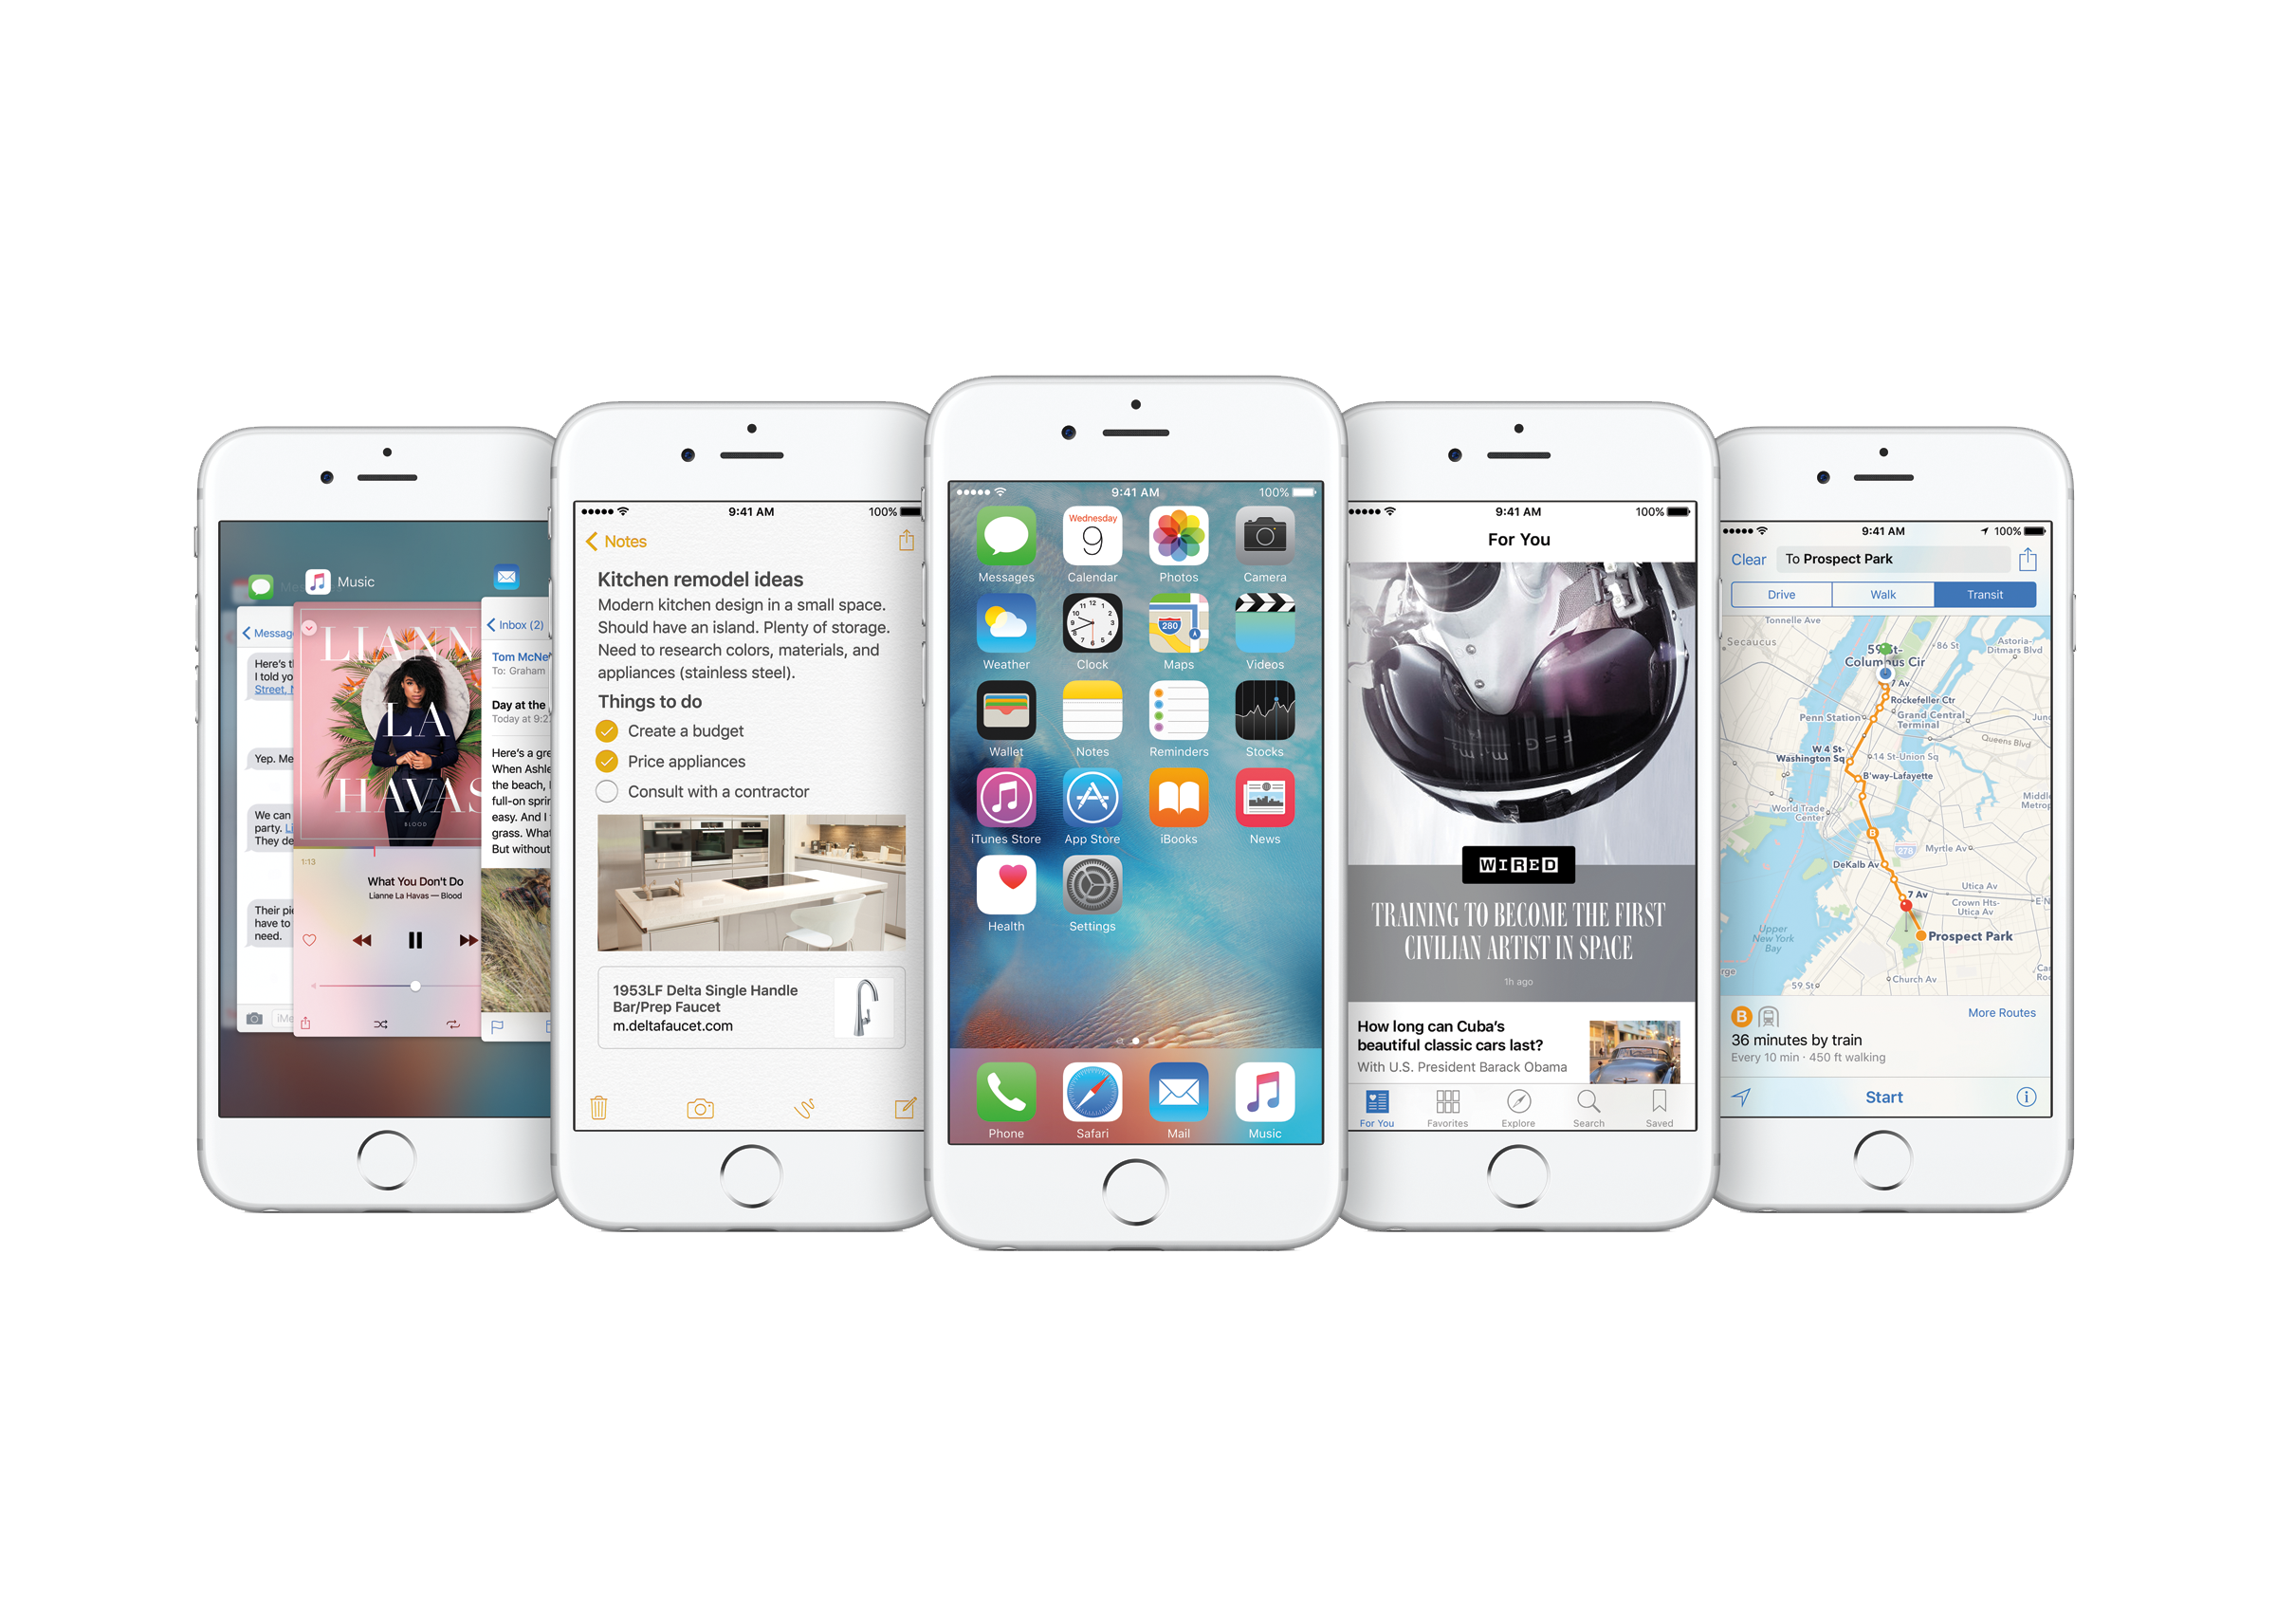
iOS 9
3D Touch
Slide Over
Split View
Picture in Picture
App Thinning
Safari View Controller
Search API
© 2016 KCL Tech Society. All rights reserved.

Slide 8
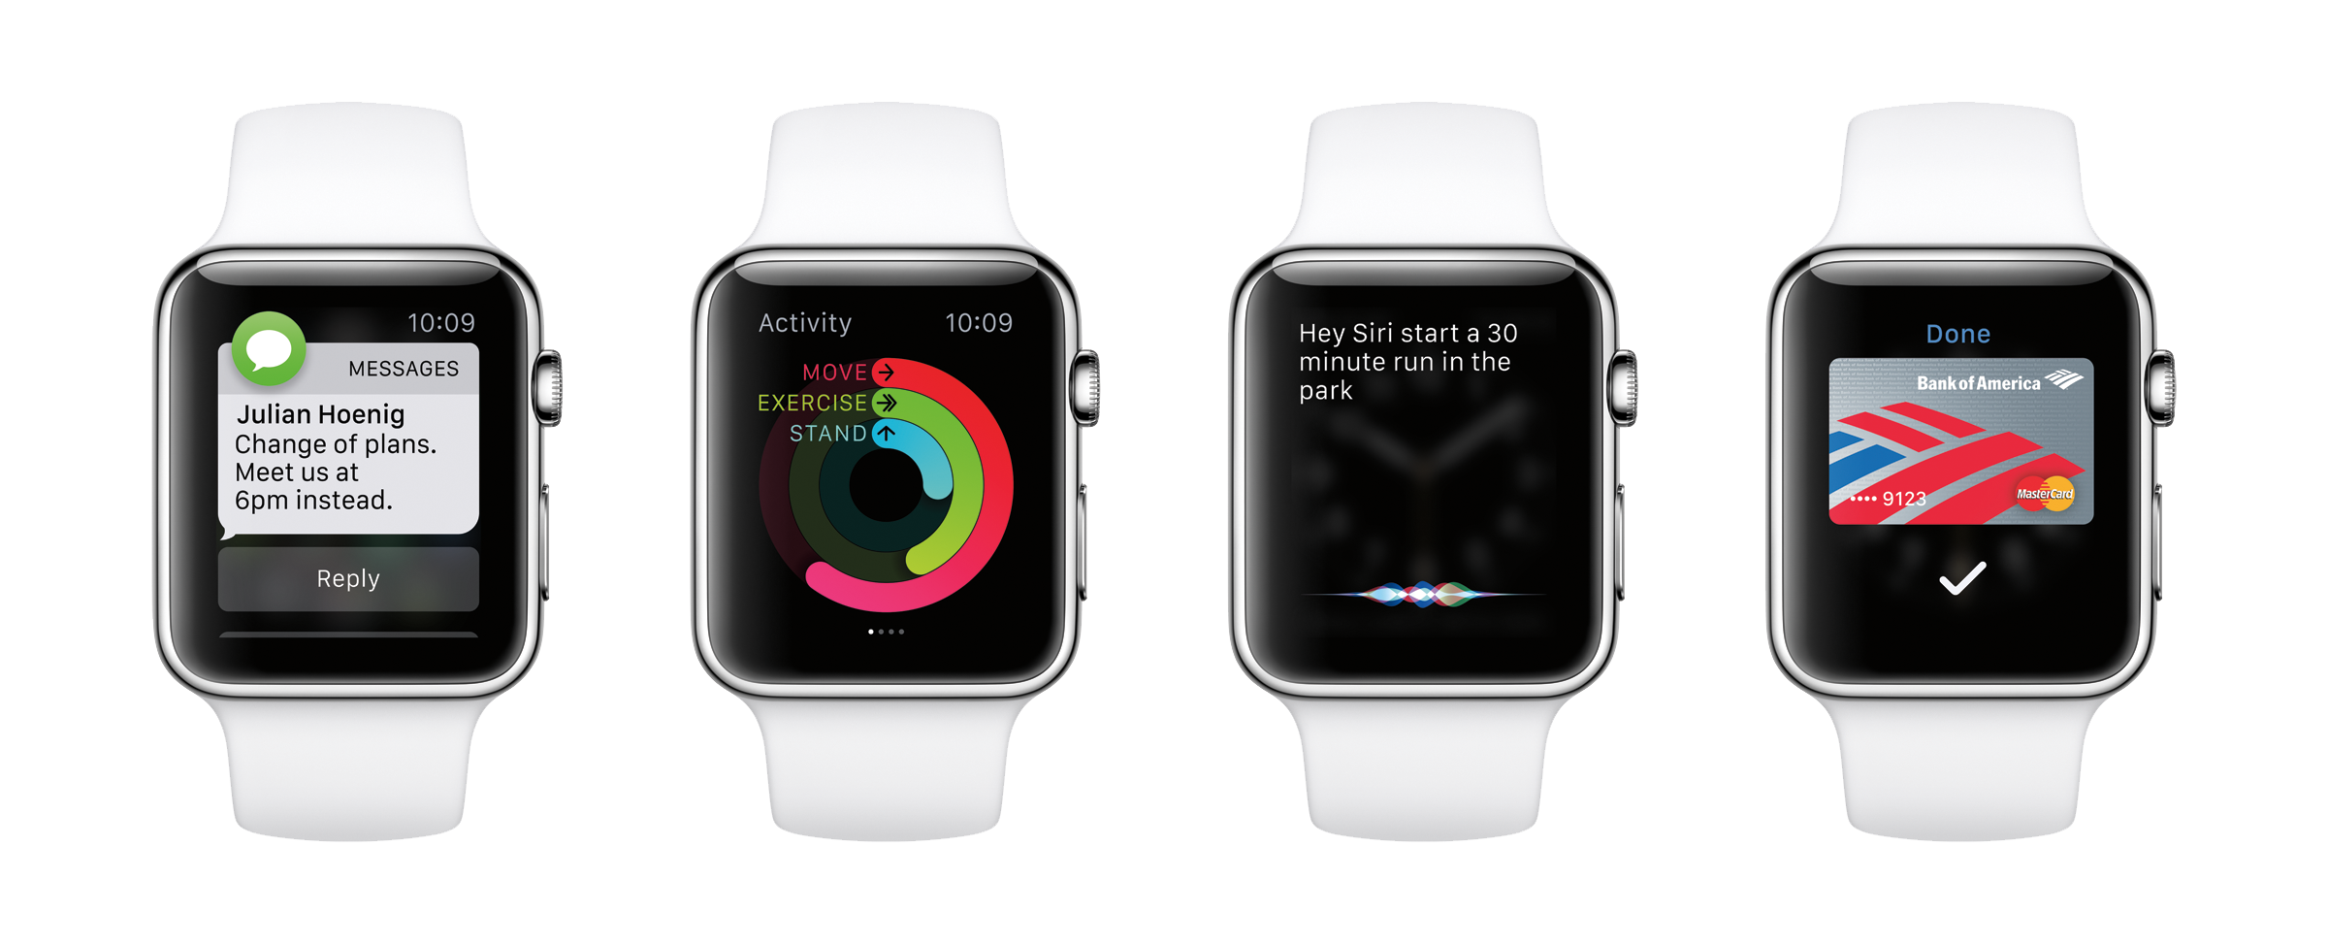
watchOS 2
Digital Crown
Audio
Animation APIs
Taptic Engine
Core Motion
ClockKit
Time Travel
WatchConnectivity
NSURLSession
© 2016 KCL Tech Society. All rights reserved.

Slide 9
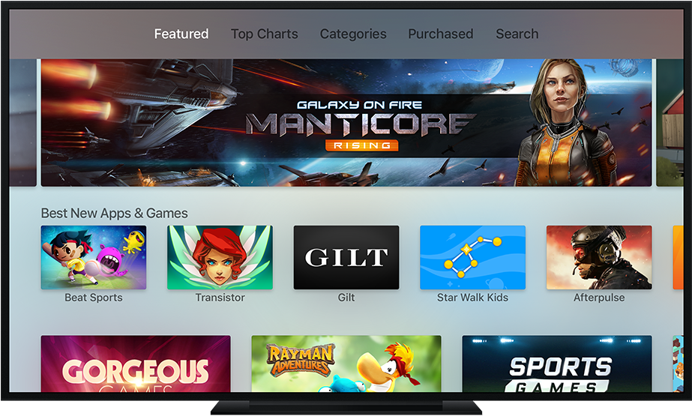
tvOS
Most Frameworks
Javascript + TVML
Remote
Siri
© 2016 KCL Tech Society. All rights reserved.

Slide 10
Demo
Xcode 7

Slide 11



Swift 2
© 2016 KCL Tech Society. All rights reserved.

Slide 12
#include <stdio.h>
int main()
{
printf(“Hello, KCL Tech\n”);
return 0;
}
print(“Hello, KCL Tech”)
© 2016 KCL Tech Society. All rights reserved.

Slide 13
Variables
var languageName: String = “Swift”
© 2016 KCL Tech Society. All rights reserved.

Slide 14
Constants and Variables
let languageName: String = “Swift”
var version: Double = 1.0
var introducedIn: Int = 2014
let introducedIn: Int = 2014
var isAwesome: Bool = true
let isAwesome: Bool = true
© 2016 KCL Tech Society. All rights reserved.

Slide 15
Type Inference
let languageName: String = “Swift”
let languageName = “Swift”
var version: Double = 1.0
var version = 1.0
let introducedIn: Int = 2014
let introducedIn = 2014
let isAwesome: Bool = true
let isAwesome = true
© 2016 KCL Tech Society. All rights reserved.

Slide 16
Unicode Names
let languageName = “Swift”
var version = 1.0
let introducedIn = 2014
let isAwesome = true
let π = 3.14159265
let 🐶🐮 = “dogcow”
© 2016 KCL Tech Society. All rights reserved.

Slide 17
Combining Strings and Characters
let dog = “dog”
let cow = “cow”
let dogCow = dog + cow
// dogCow is “dogcow”
© 2016 KCL Tech Society. All rights reserved.

Slide 18
Building Complex Strings
let a = 3
let b = 5
// “3 times 5 is 15”
let result = “\(a) times \(b) is \(a * b)”
© 2016 KCL Tech Society. All rights reserved.

Slide 19
String Mutability
var variableString = “Horse”
variableString += “ and carriage”
//variableString is now “Horse and carriage”
let constantString = “Horse”
constantString += “ and carriage”
//error
© 2016 KCL Tech Society. All rights reserved.

Slide 20
Array and Dictionary
var names = [“Anna”, “Brian”, “Jack”]
var numberOfLegs = [“ant”: 6, “snake”: 0]
© 2016 KCL Tech Society. All rights reserved.

Slide 21
Typed Collections
var names = [“Anna”, “Brian”, “Jack”]
© 2016 KCL Tech Society. All rights reserved.

Slide 22
Typed Collections
var names = [“Anna”, “Brian”, “Jack”, 42]
© 2016 KCL Tech Society. All rights reserved.

Slide 23
Typed Collections
var names = [“Anna”, “Brian”, “Jack”, true]
© 2016 KCL Tech Society. All rights reserved.

Slide 24
Typed Collections
var names: String[] = [“Anna”, “Brian”, “Jack”]
var ages = Int[]()
let values = Int[](count: 5, repeatedValue: 1)
© 2016 KCL Tech Society. All rights reserved.

Slide 25
Typed Collections
var names = [“Anna”, “Brian”, “Jack”]
// an array of String values
var numberOfLegs = [“ant”: 6, “snake”: 0]
// a Dictionary with String keys and Int values
© 2016 KCL Tech Society. All rights reserved.

Slide 26
Loops
var index = 0
repeat {
index++
} while index < 5
while hungry {
eatCake()
}
for var i = 0; i < 10; i++ {
eat(i)
}
© 2016 KCL Tech Society. All rights reserved.

Slide 27

For-In: Strings and Characters
for character in “🐭🐭🐭🐭🐭” {
print(character)
}
© 2016 KCL Tech Society. All rights reserved.

Slide 28
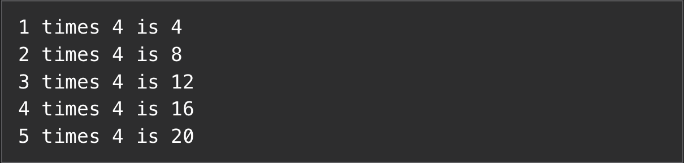
For-In: Ranges
1..<5
for number in 1…5 {
print(“\(number) times 4 is \(number*4)”)
}
© 2016 KCL Tech Society. All rights reserved.

Slide 29

For-In: Arrays
for name in [“Anna”, “Brian”, “Jack”] {
print(“Hello, \(name)!”)
}
Hello, Anna!
Hello, Brian!
Hello, Jack!
© 2016 KCL Tech Society. All rights reserved.

Slide 30
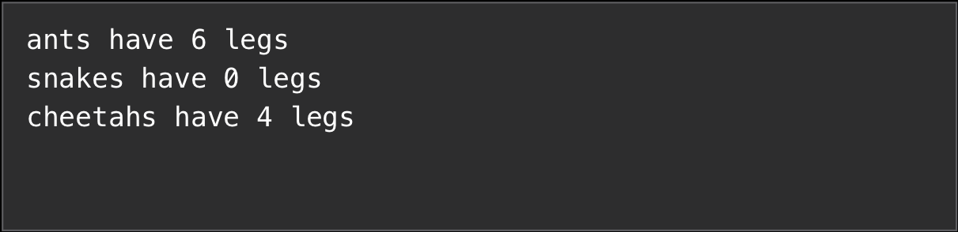
For-In: Dictionaries
var numberOfLegs = [“ant”: 6, “snake”: 0, “cheetah”: 4]
for (animal, leg) in numberOfLegs {
print(“\(animal)s have \(leg) legs”)
}
© 2016 KCL Tech Society. All rights reserved.

Slide 31
If Statements
if legCount == 0 {
print(“It slides”)
} else {
print(“It walks”)
}
© 2016 KCL Tech Society. All rights reserved.

Slide 32
More Complex If Statements
if legCount == 0 {
print(“It slides”)
} else if legCount == 1 {
print(“It hops”)
} else {
print(“It walks”)
}
© 2016 KCL Tech Society. All rights reserved.

Slide 33
Switch
switch legCount {
case 0:
print(“It slides”)
case 1:
print(“It slides”)
default:
print(“It slides”)
}
© 2016 KCL Tech Society. All rights reserved.

Slide 34
Switch
switch legCount {
case 0:
print(“It slides”)
case 1,3,5,7,9:
print(“It hops”)
case 2,4,6,8,10:
print(“It walks”)
default:
print(“No idea”)
}
© 2016 KCL Tech Society. All rights reserved.

Slide 35
Switch
switch textField {
case userNameTextField:
print(“You tapped the username text field”)
case passwordTextField:
print(“You tapped the password text field”)
default:
print(“You tapped some other object”)
}
© 2016 KCL Tech Society. All rights reserved.

Slide 36
Switch
let point = (1, -1)
switch point {
case let (x, y) where x == y:
print(“x equals with y”)
case let (x, y) where x == -y:
print(“x is the abs of y”)
case let (x, y):
print(“x and y are two coordinates”)
}
© 2016 KCL Tech Society. All rights reserved.

Slide 37
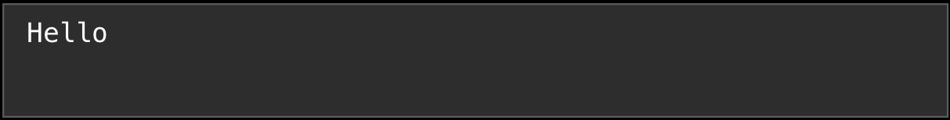
Functions
func sayHello() {
print(“Hello!”)
}
sayHello()
© 2016 KCL Tech Society. All rights reserved.

Slide 38
Functions with Parameters
func sayHello(name: String) {
print(“Hello \(name)!”)
}
sayHello(“WWDC”)
Hello, WWDC!
© 2016 KCL Tech Society. All rights reserved.

Slide 39
Functions with Parameters
func sayHello(name: String, age: Int) {
print(“Hello \(name), \(age)!”)
}
sayHello(“Peter”, age: 20)
func sayHello(name: String, _ age: Int) {
print(“Hello \(name), \(age)!”)
}
sayHello(“Peter”, 20)
© 2016 KCL Tech Society. All rights reserved.

Slide 40
Functions with Parameters
func addListOfParams(params: String…) {
// Do something with params
}
addListOfParams(“Name”, “Peter”, “Age”, “Cat”)
© 2016 KCL Tech Society. All rights reserved.

Slide 41
Returning Values
func sayHello(name: String) -> String {
return “Hello ” + name
}
let greeting = sayHello(“WWDC”)
printl(greeting)
Hello, WWDC
© 2016 KCL Tech Society. All rights reserved.

Slide 42
Returning Multiple Values
func refreshWebPage() -> (Int, String) {
//…try to refresh…
return (200, “Success”)
}
© 2016 KCL Tech Society. All rights reserved.

Slide 43
Functions in General
func functionName(variableName: ParamType) -> ReturnType {
return Variable as ReturnType
}
© 2016 KCL Tech Society. All rights reserved.

Slide 44
Demo
Swift in Playground

